Slide 1

Python Project - INT216
Uber Supply-Demand Gap
Case study
Ishaant Kumar Singh
12203987
Roll No. 47

Slide 2
Abstract
Problem statement:
Uber is facing driver cancellation and non- availability of cabs to and fro airport leading to impact on the business and loss of potential revenue.
Objective:
To identify the root cause of the supply-demand gap of cabs to and fro airport.
Data used for analysis:
The data used is only to and fro airport
The span of the data is of 5 days.

Slide 3
Problem solving methodology
Data collection and cleaning
Data exploration and analysis
Outcome and recommendations
Import the data
Identifying the data quality issues and clean the data
Format date and time variables
Extract new variables required for analysis
Analyze different variables
Analyze variables across different time slots
Identify the types of requests, time slots and locations that constitute for the supply demand gap.
Visualizing the problem
Presenting the observations
Recommendation to resolve the problem

Slide 4
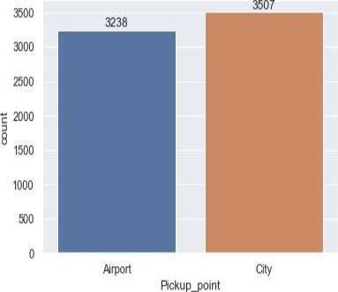
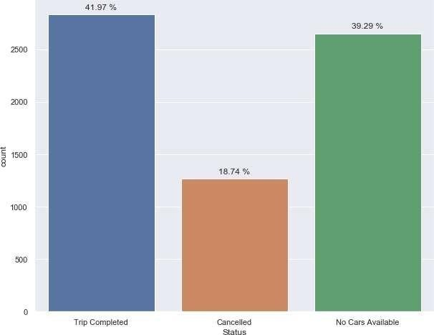
Problem
Overall request is the same in city and airport
From the request, around 19% of the cabs get cancelled
From the request, around 39% of the cabs are not available.

Slide 5
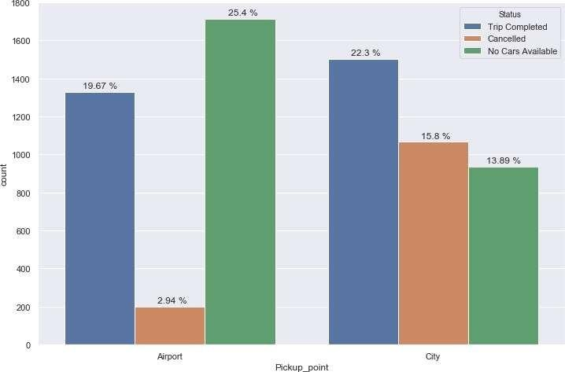
Further analysis of the problem based on location
The % of cabs that get cancelled from city is 16%
‘No cars available’ - is mainly at the airport – 25%

Slide 6
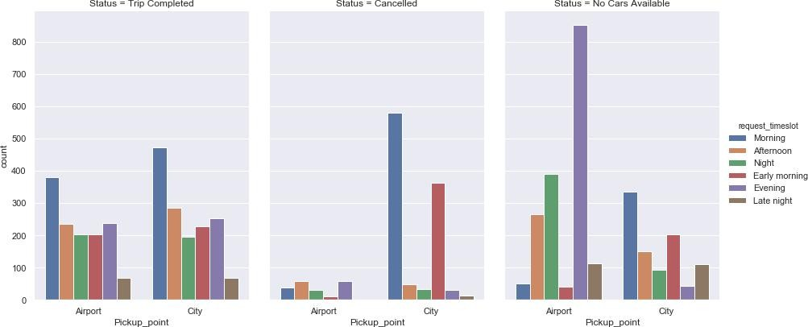
Further analysis of the problem based on time
The cabs that get cancelled in the city are during the morning hours(5am to 9am)
No cars are available in the airport are during evening hours (5pm to 10 pm)

Slide 7
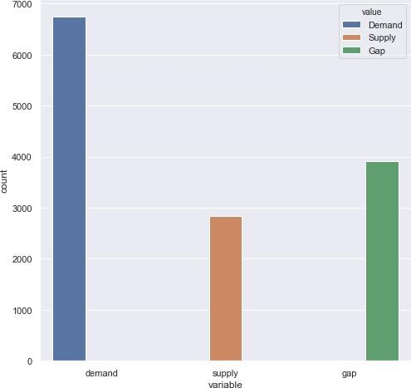
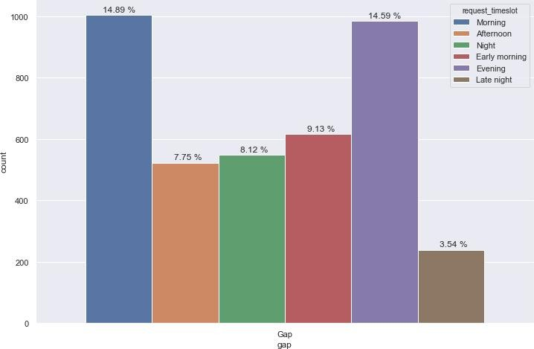
Analysis of supply-demand gap
There is gap of 58% in the supply of cabs.
In that 58% : 15% gap happens in the morning and evening timeslot each.

Slide 8
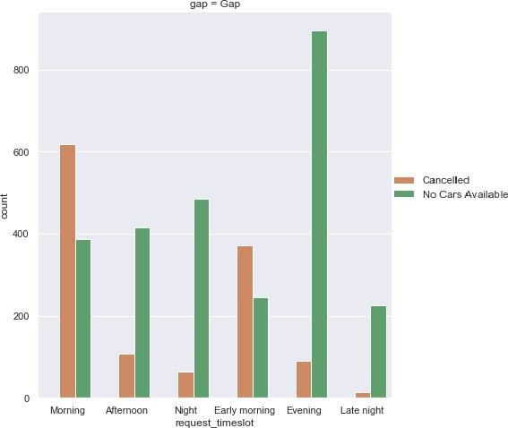
Supply-demand gap based on time
As we saw that 15% of the gap that exist in the morning is due to cancellation
15% of the gap that exist in the evening is due to no cars availability.

Slide 9
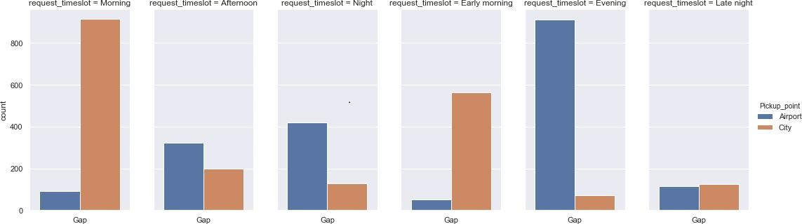
Supply-demand gap based on location
15% of the gap that exist in the morning due to cancellation is at City
15% of the gap that exist in the evening due to no cars availability is at Airport.

Slide 10
Possible reasons for the issue:
In the morning hours:
Though there is a high demand for cabs from city to airport, the vice versa is not true.
Hence the driver tends to 'cancel' the request as getting a return trip from airport to city would be tough.
In the evening hours:
Though there is high demand for cabs from airport to city, the vice versa is again not true. Hence 'no cars available' in the airport is the highest in the evening.
This brings us to solution and recommendation to the problem!

Slide 11
Possible solutions and recommendations
Provide incentives for airport trips during peak time.
Assigning few extra cabs specially to the airport trips.
Fixing a base price for drivers idle time in the airport or to come back to the city without any passenger.
Impose penalty for cancellation of requests by the drivers. Set a threshold for the maximum cancellation per day.
Promote continuous trip to airport with incentives.
Promote advance booking to airports and at the same time keeping drivers updated with the flight schedule will help them plan their work and they can accept the request as per their work plan.

